Slide 1
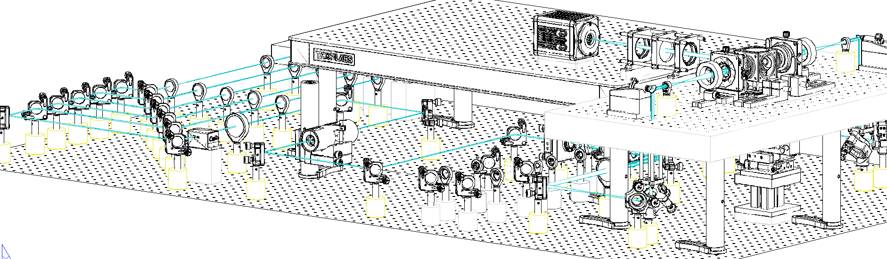
A
galvo
561 nm
515 nm
491 nm
445 nm
405 nm
f 200
f 50
f 140
f 350
f 100
Detection
Olympus
25×, 1.0NA
WD: 8mm
v
f 200
Axicon
f 50
D
Camera
LP 552
filter
PBS
LP 503
I
f 200
Nikon CFI LU Plan Fluor EPI 10×, NA 0.30, WD 17.5 mm
LP 466
I
f 350
f 150
LP 427
f 100
f 50
f 150
LM
f 50
C
AOTF
f 100
I1
f 250
I2
f 50
f 150
galvo
A
B
f 200
B

Slide 2
A
galvo
561 nm
515 nm
491 nm
445 nm
405 nm
f 200
f 50
f 140
f 350
f 100
v
f 200
f 200
Camera
LP 552
filter
PBS
LP 503
LP 466
f 350
f 150
LP 427
f 100
f 150
LM
f 50
AOTF
I1
I2
f 50
f 150
galvo
f 200
B

Slide 3
A
561 nm
515 nm
491 nm
445 nm
405 nm
Detection
Olympus
25×, 1.0NA
WD: 8mm
v
f 200
galvo
Camera
filter
f 200
f 50
f 140
f 350
f 100
v
f 200
Axicon
f 50
D
LP 552
PBS
LP 503
I
Nikon CFI LU Plan Fluor EPI 10×, NA 0.30, WD 17.5 mm
LP 466
I
f 350
f 150
LP 427
f 100
f 50
f 150
LM
f 50
C
AOTF
f 100
f 250
galvo
I1
I2
f 50
f 150
A
B
f 200
B
Motor
stages
Periscope

Slide 4
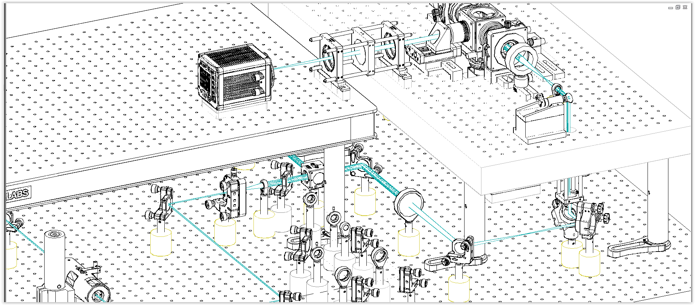
A
561 nm
515 nm
491 nm
445 nm
405 nm
Detection
Olympus
25×, 1.0NA
WD: 8mm
v
f 200
galvo
Camera
filter
f 200
f 50
f 140
f 350
f 100
v
f 200
Axicon
f 50
D
LP 552
PBS
LP 503
I
Nikon CFI LU Plan Fluor EPI 10×, NA 0.30, WD 17.5 mm
LP 466
I
f 350
f 150
LP 427
f 100
f 50
f 150
LM
f 50
C
AOTF
f 100
f 250
galvo
I1
I2
f 50
f 150
A
B
f 200
B

Slide 5
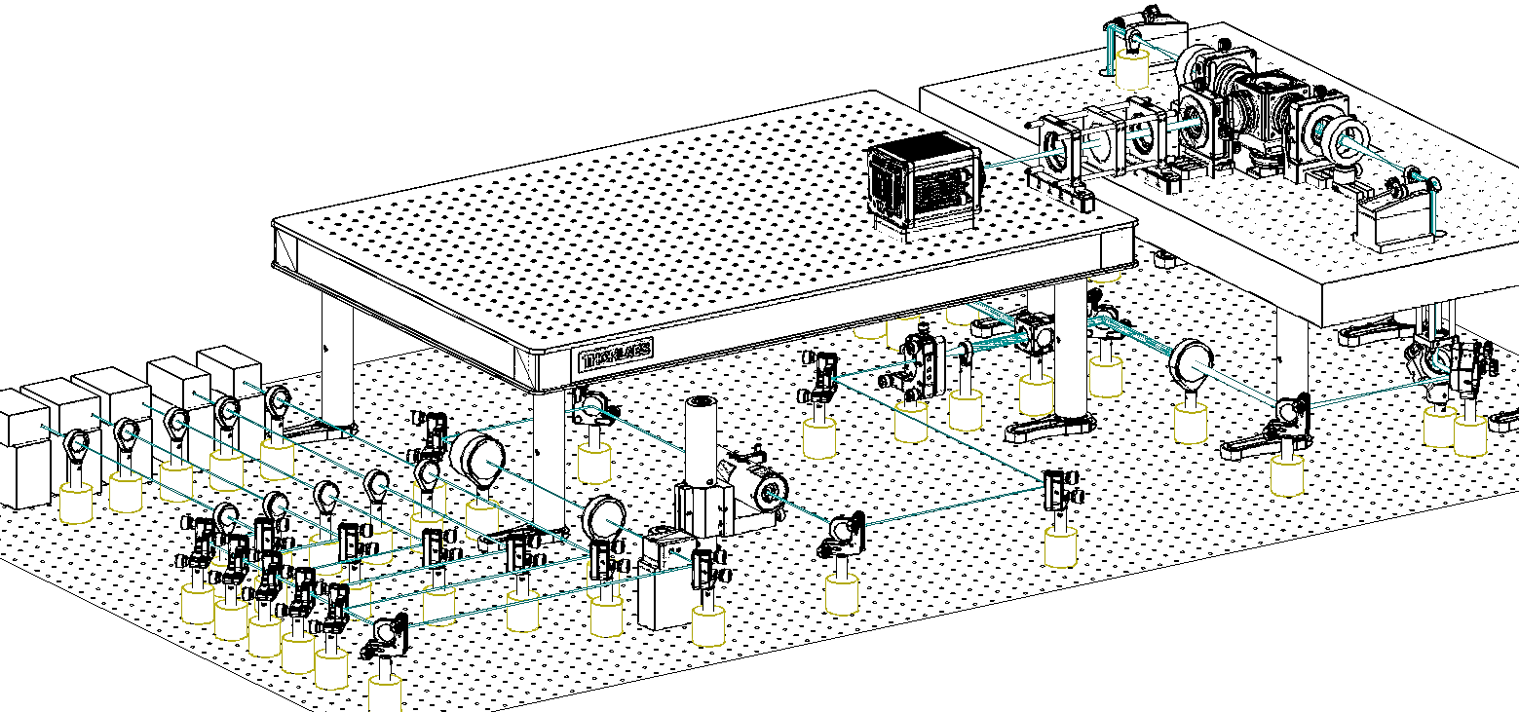

Slide 7
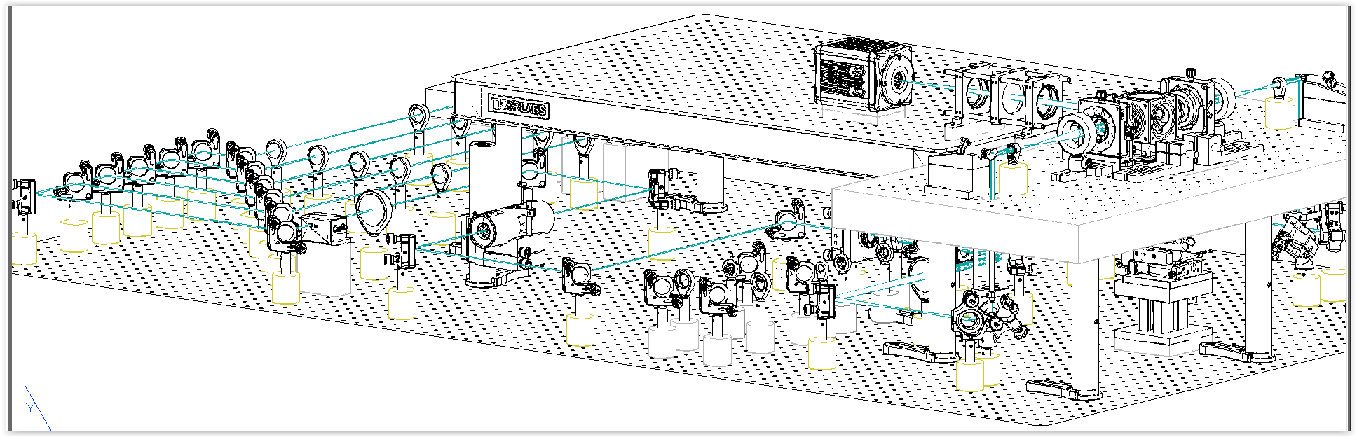

Slide 8
Olympus XLSLPLN25XGMP
25×, 1.0NA
WD: 8mm
Camera
f 200

Slide 9
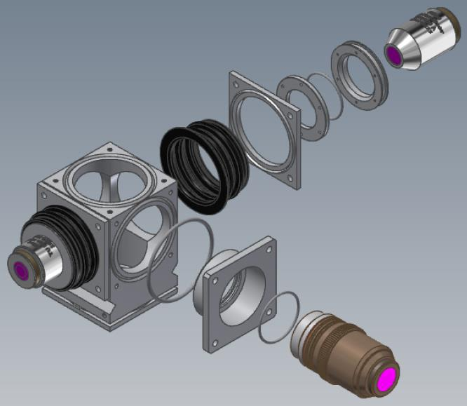
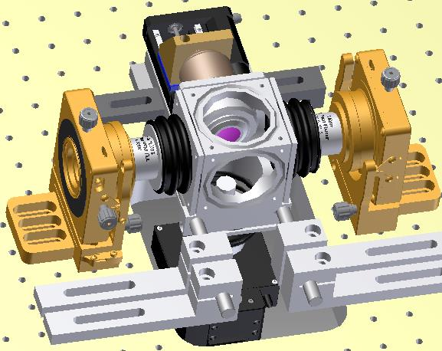
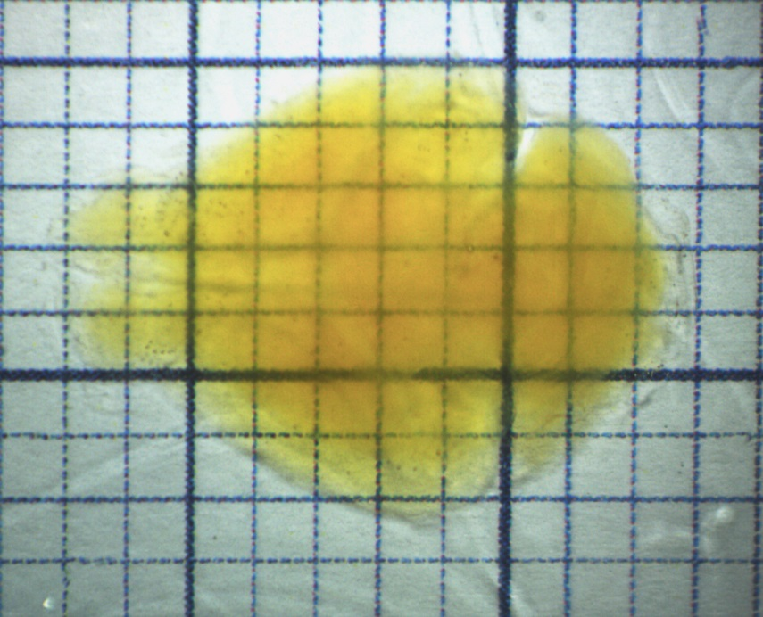
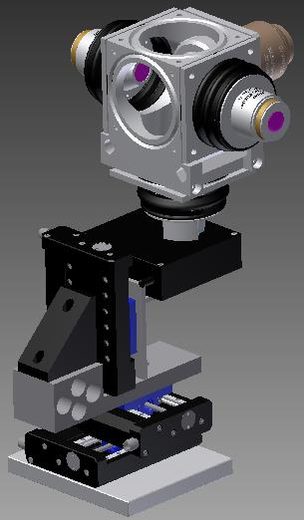
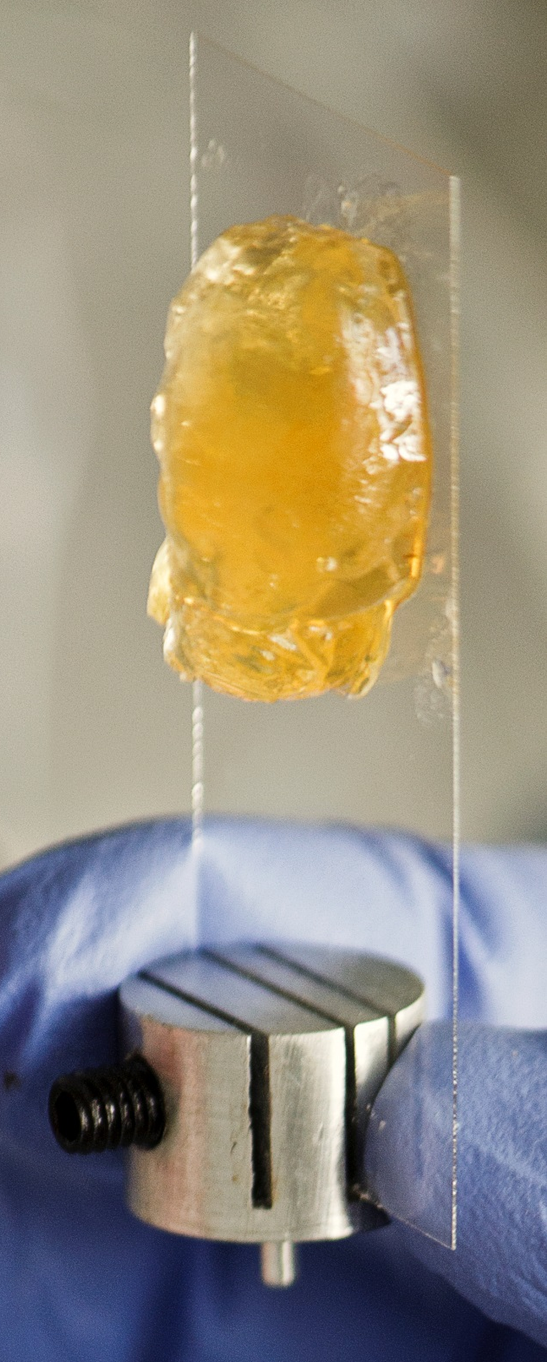
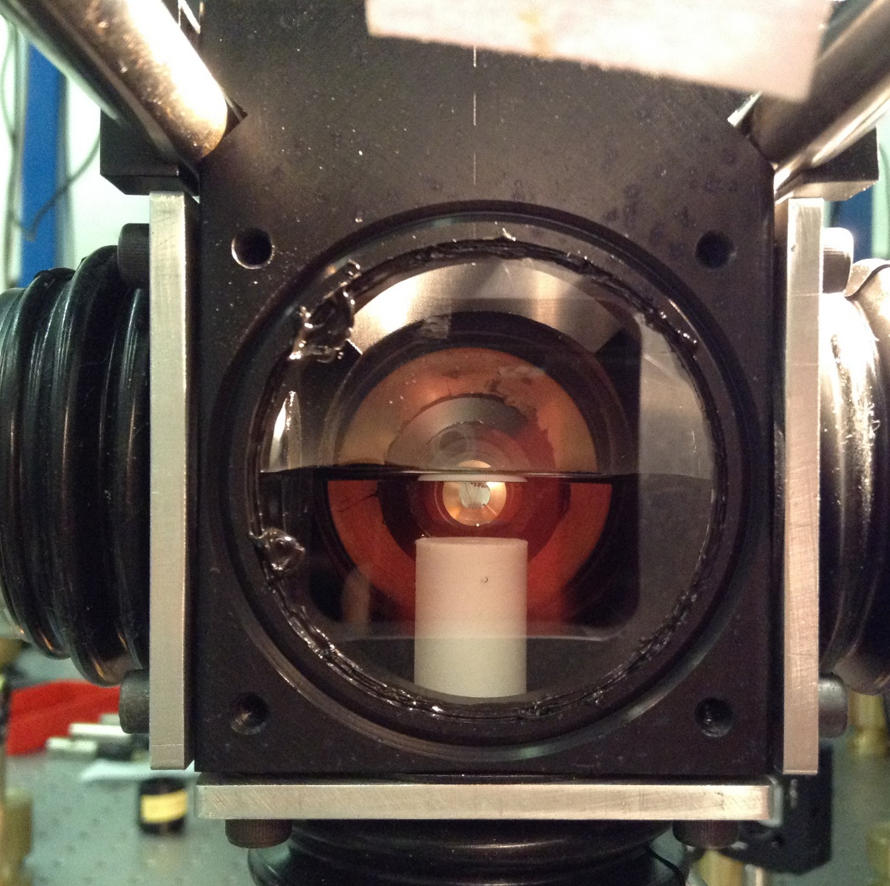
z
A
B
D
E
x
C

Slide 10
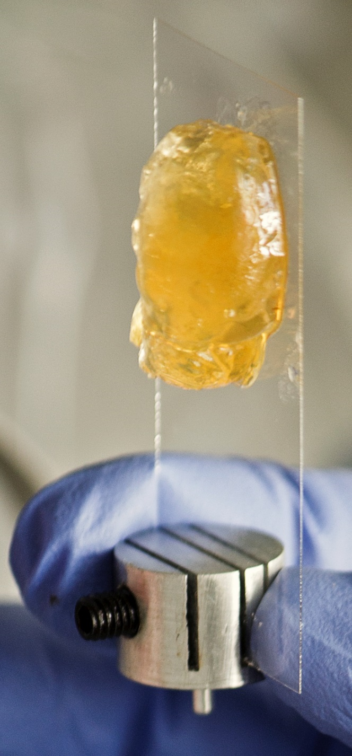

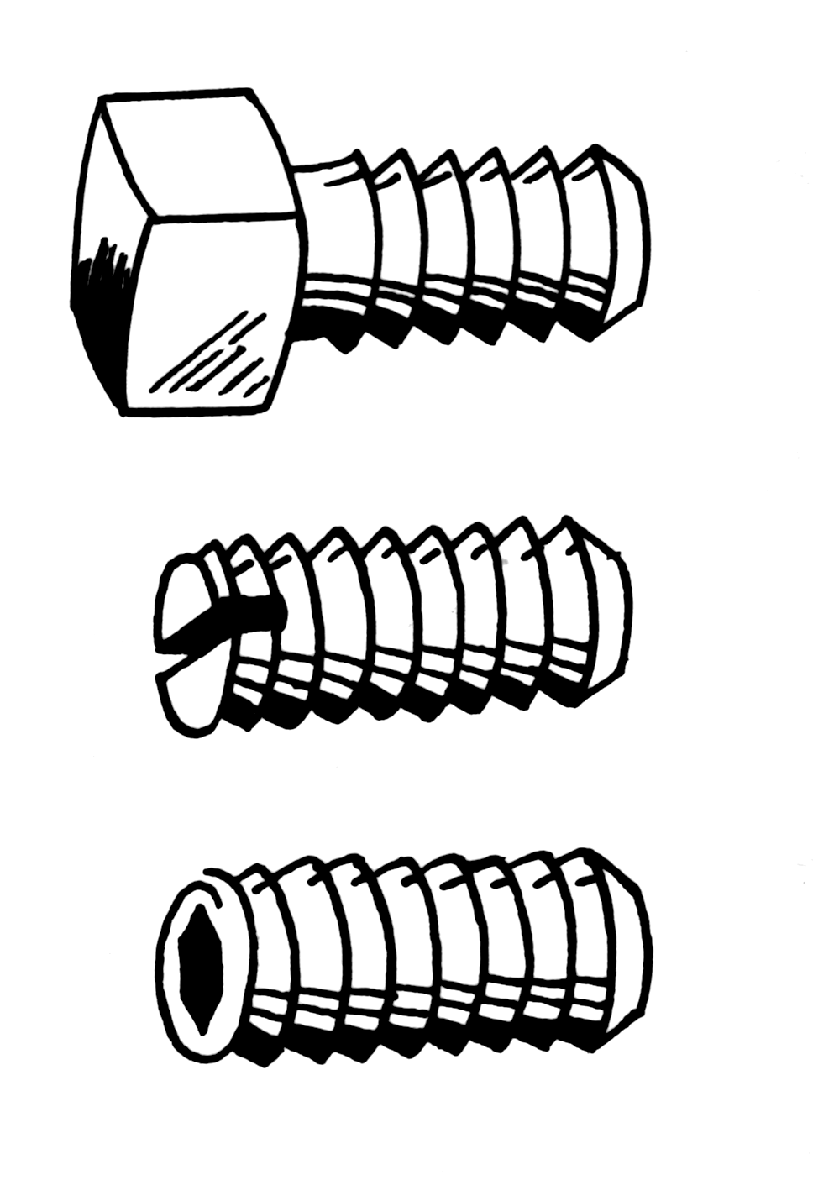
A
z
B
D
E
x
C

Slide 11
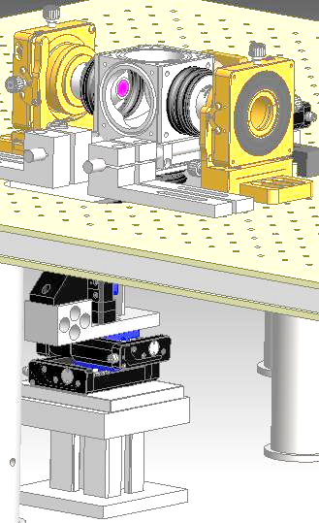
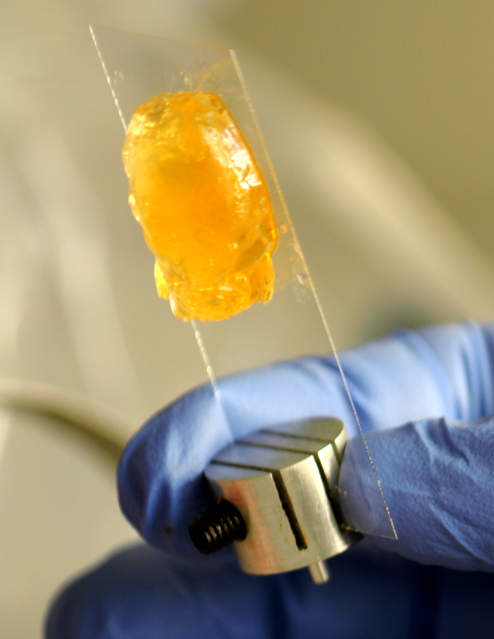
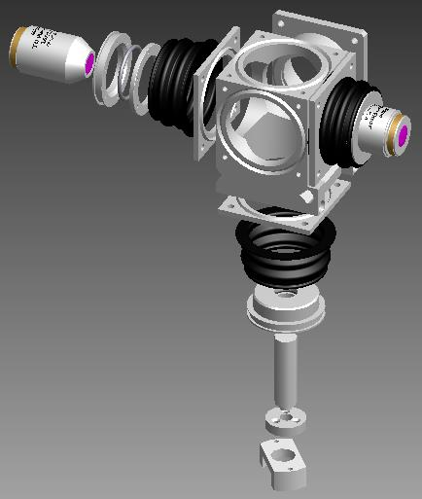

Slide 12
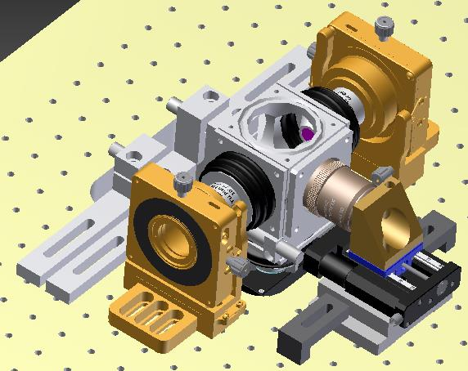
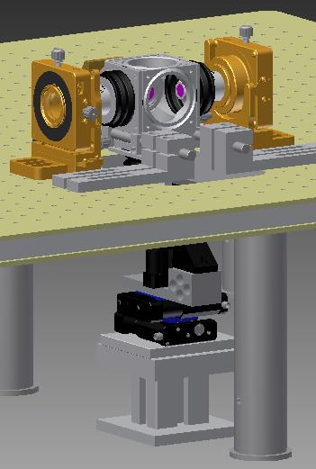
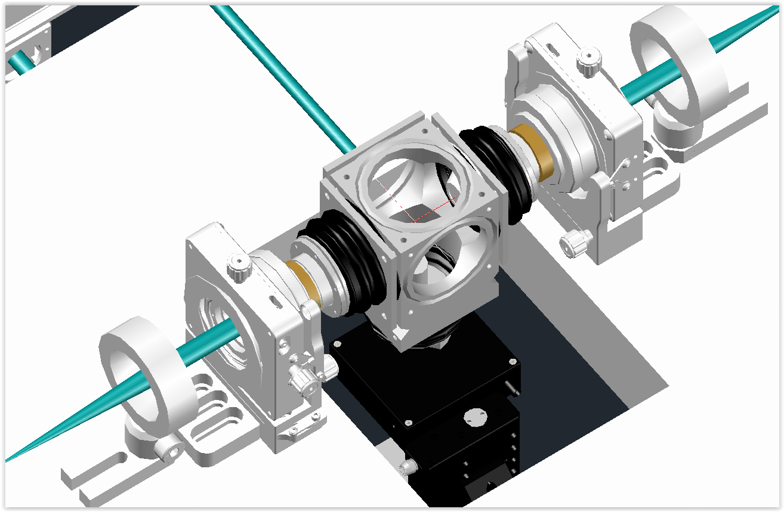

Slide 13
B

Slide 14
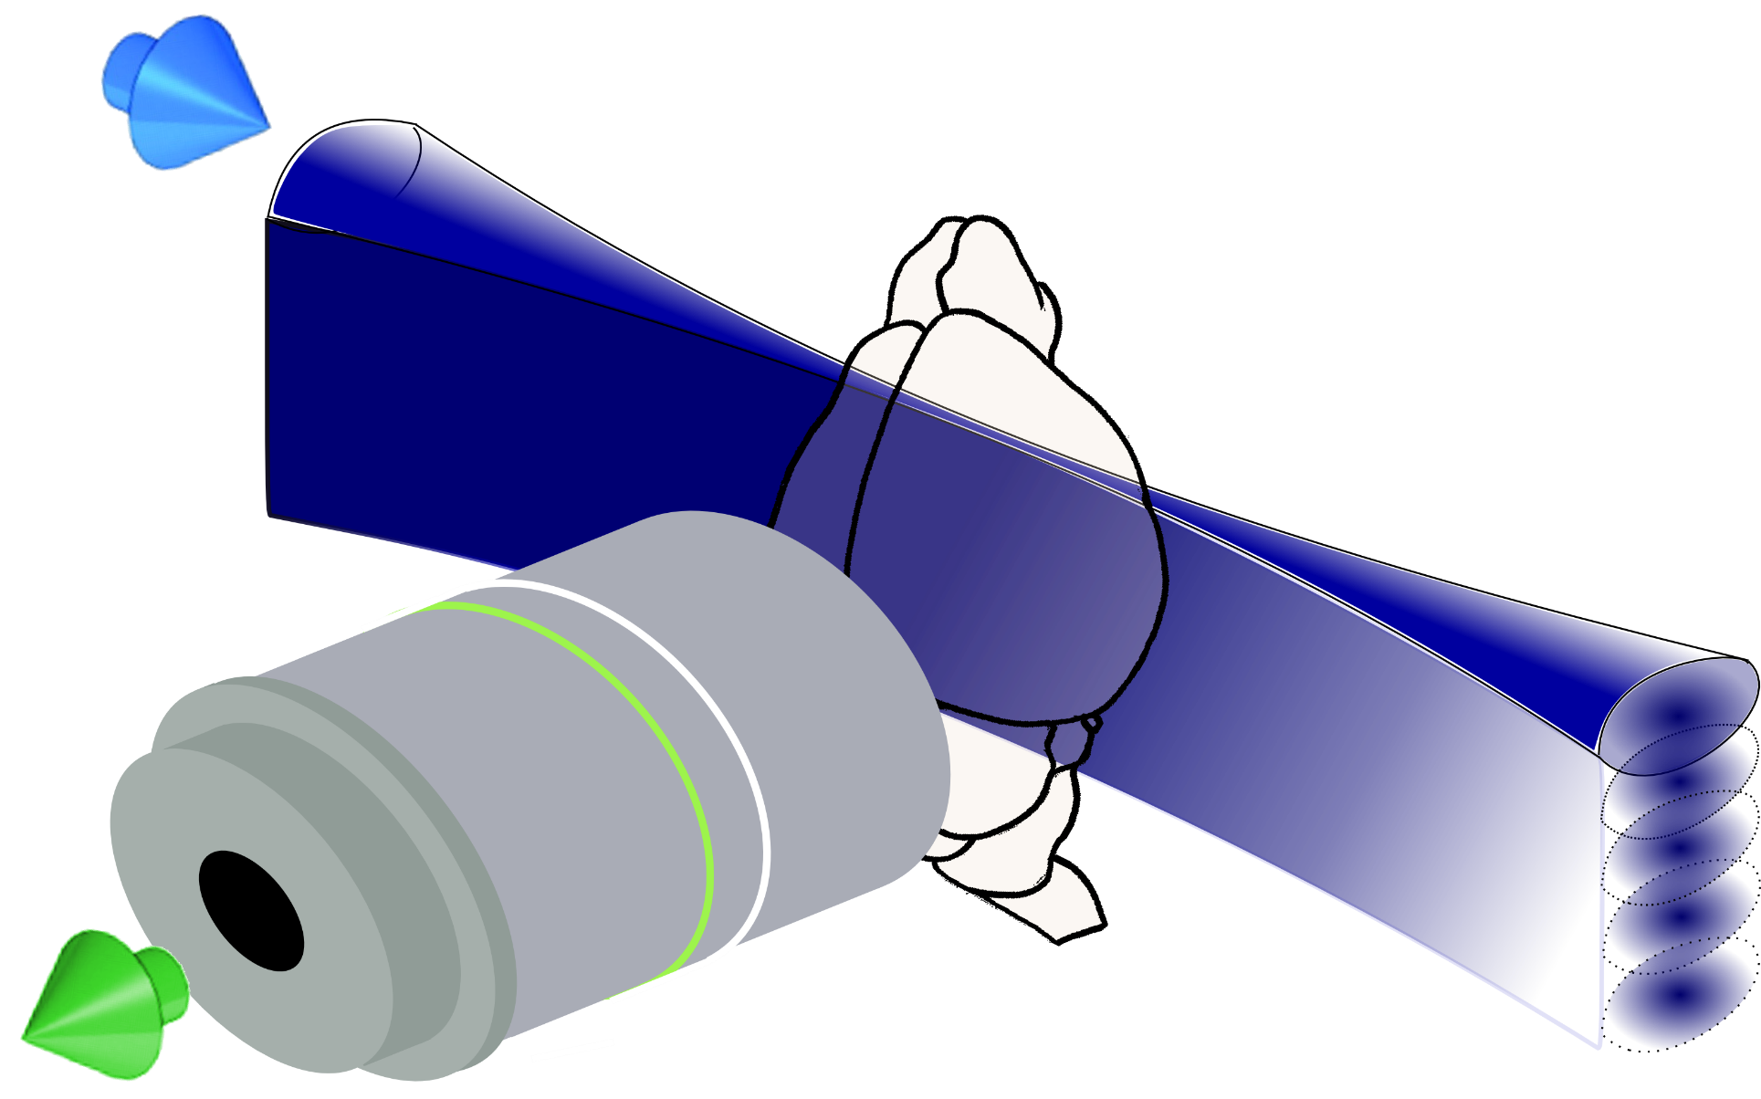

Slide 15
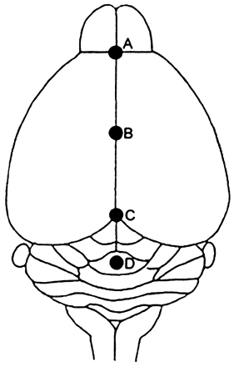
Camera
f 100
f 200
Olympus XLSLPLN25XGMP
25×, 1.0NA
WD: 8mm
f 100
DMM
f 80
f 300

Slide 16
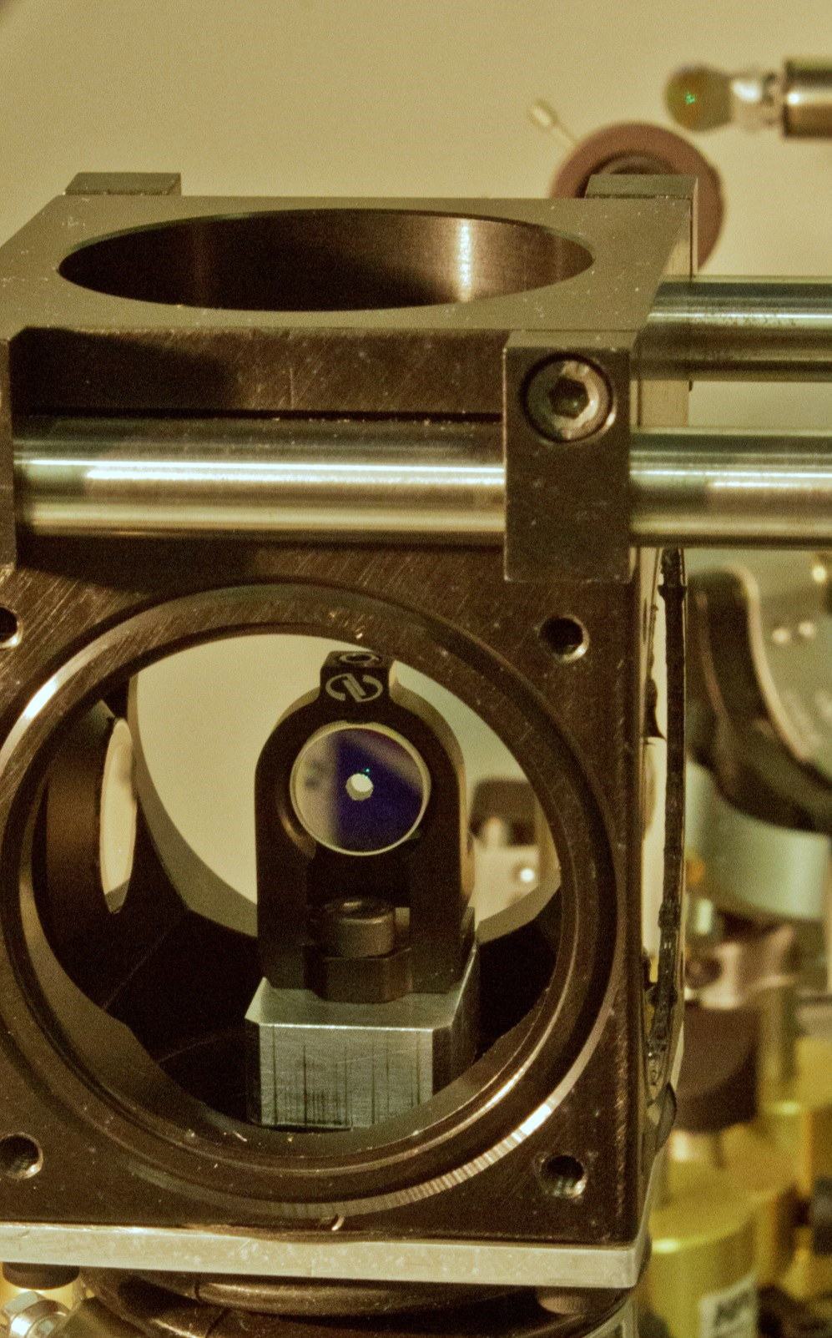
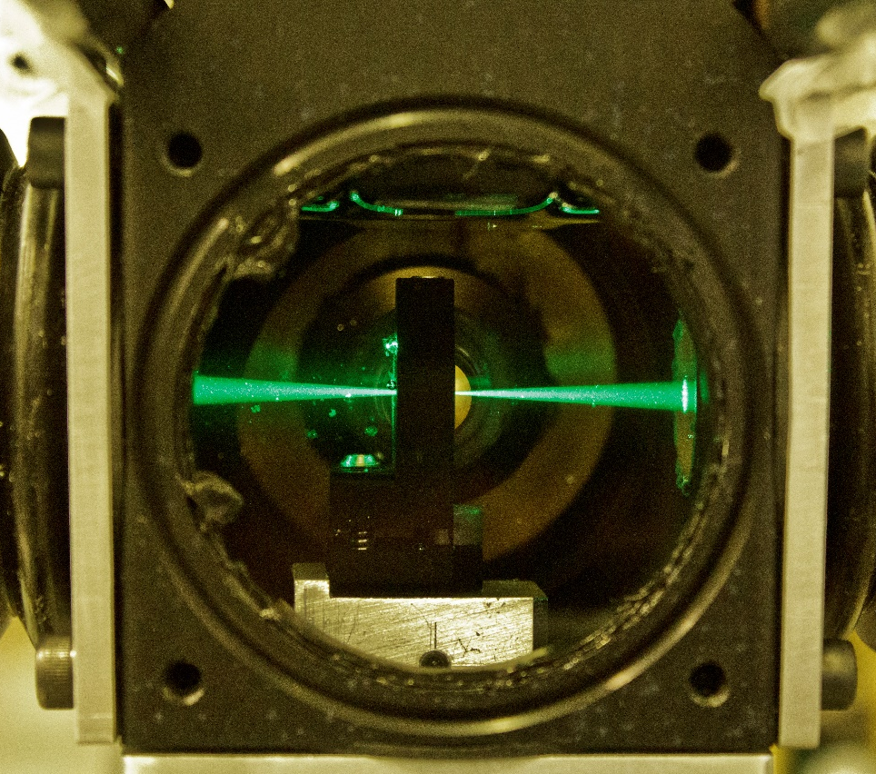
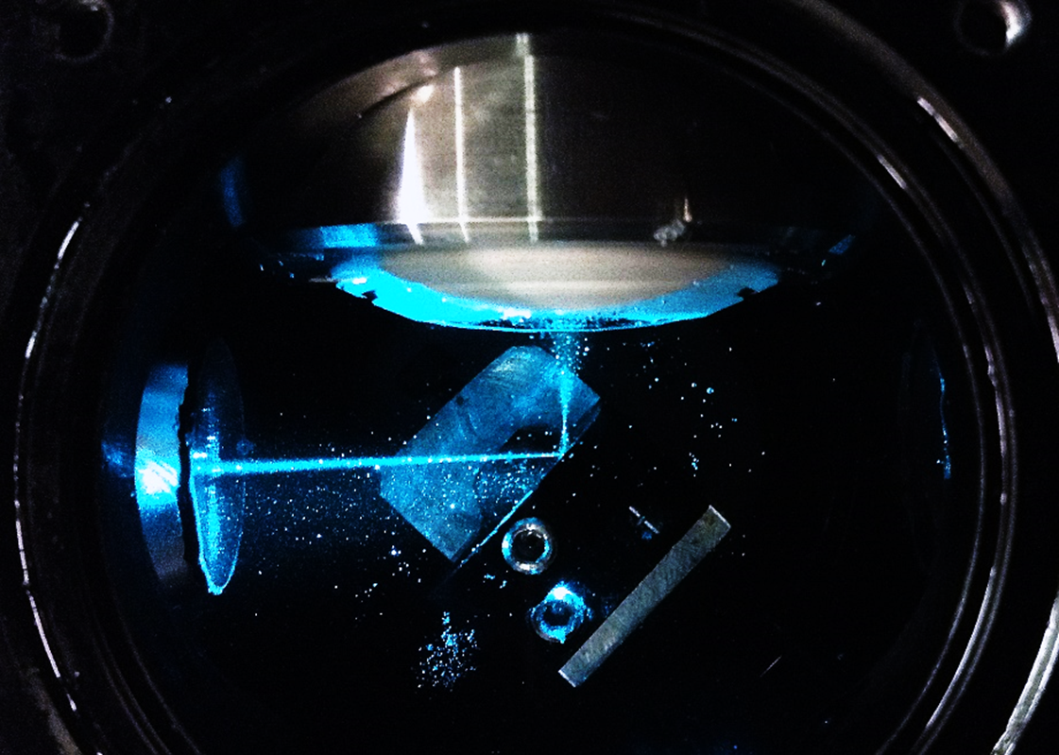
A
Camera
B
C
PBS
AD 350
AD 350
AD 200
D
AD 200
AD 200
v
AD 50
AD 100
AD 100
AD 50

Slide 17
Camera
1’ image plane
PBS
AD 350
AD 350
AD 200
AD 200
AD 200
1’ image plane
BFP
1’ image plane
BFP
BFP
galvo
v
galvo
AD 50
AD 100
AD 100
AD 50
object
plane
4f
4f

Slide 18
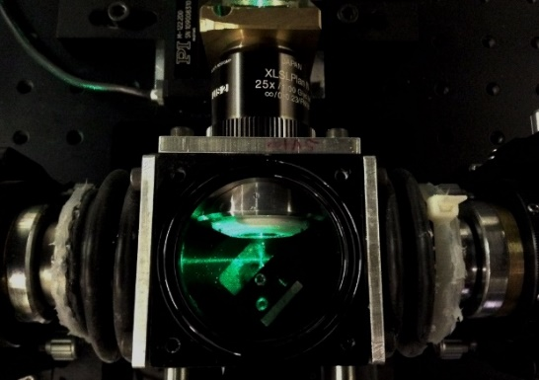

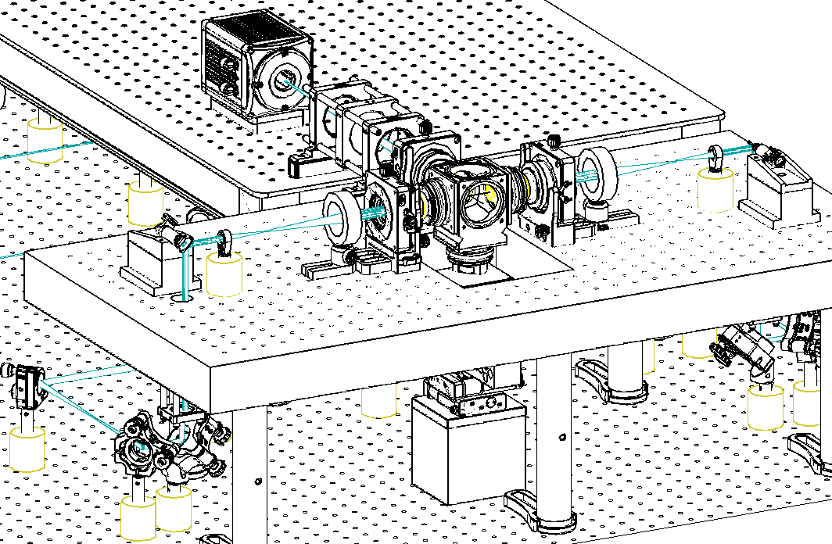
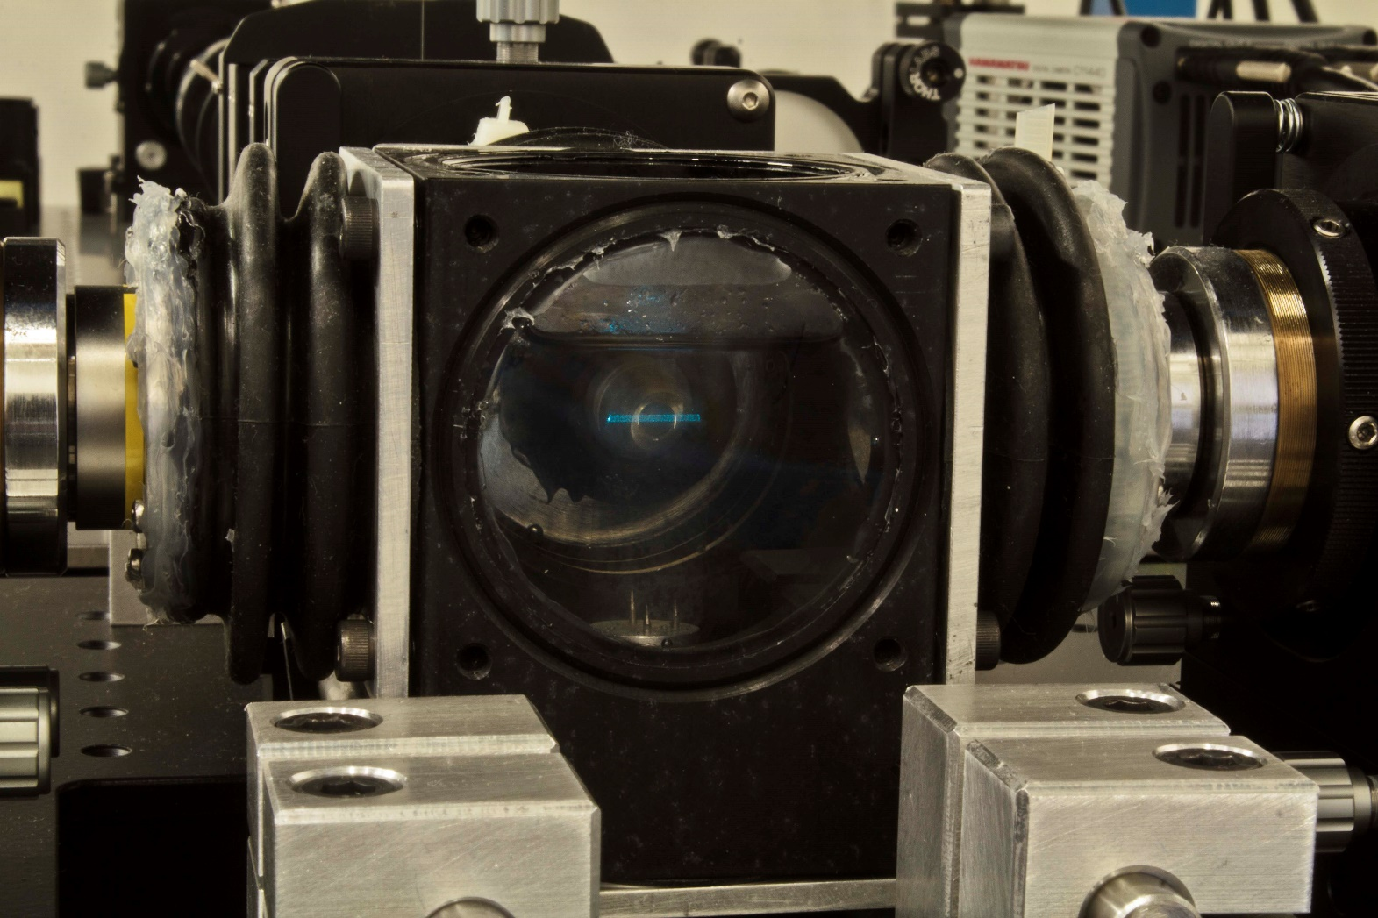
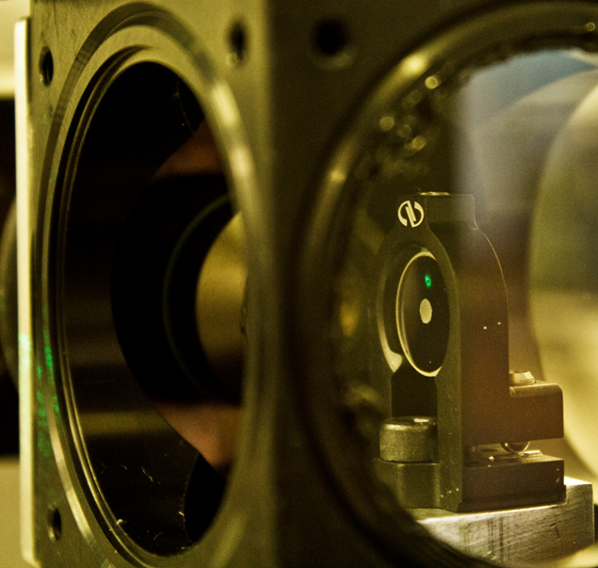

Slide 19
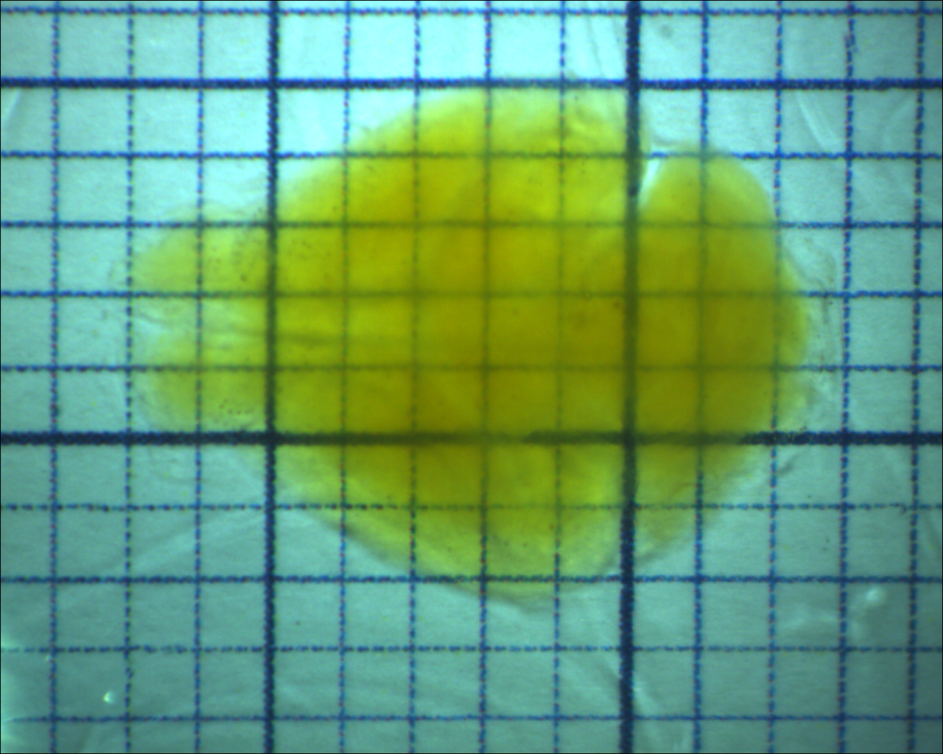

Slide 20
A
B
Tomo
Motor stages
USB
X
Y
Z
θ
Laser
Stack
Data Transfer
PC 1
USB
RS232
Laser
RS232 Hub
Laser
Laser
AOTF
Laser
RS232
Camera
Motor Stages
Galvo A
DAQ
AO
Galvo B
BNC
Ethernet
Custom Eletronics
Pulse
Amp.
Laser
Mod.
Int. BUS
AO & DO
BNC
Waveform
Generator
AOTF
DI
PC 2
BNC
Trigger output
Camera
CameraLink
DAQ controller
Lasers

Slide 21
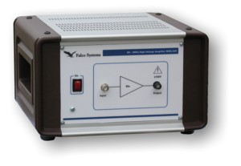
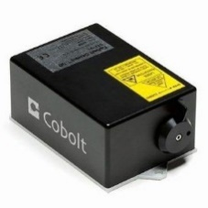
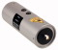
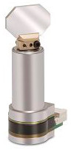
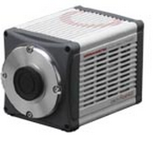
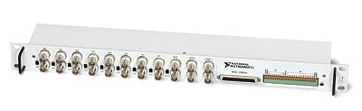
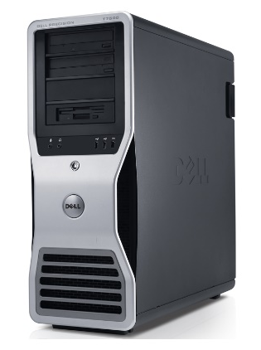
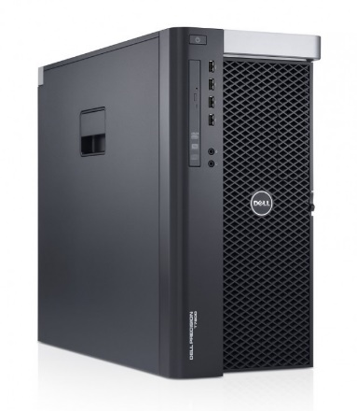
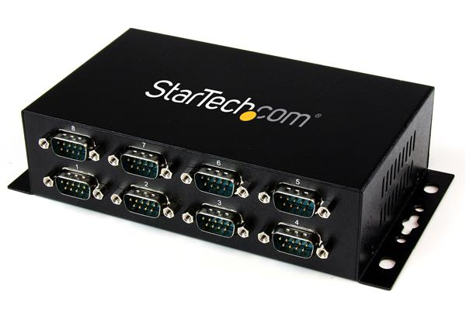
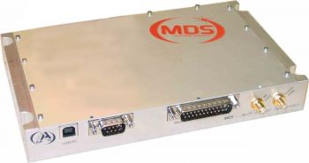
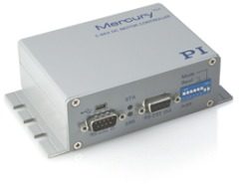

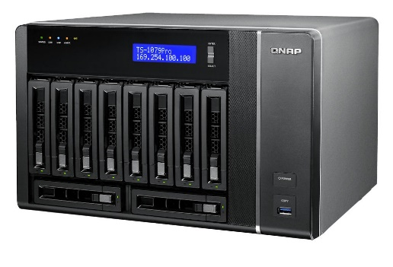
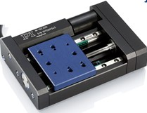
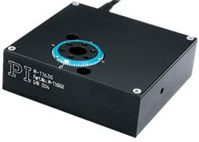
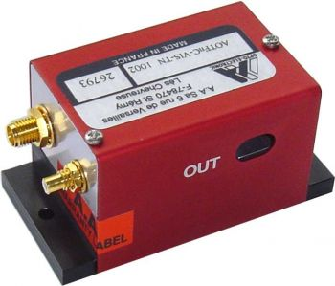
Connections
Pulse amplifier
EOM
Galvo 1
1 Gb/s ethernet
405 nm laser
10 Gb/s SFP+
Camera
DAQ
Galvo 2
445 nm laser
CameraLink
Co-axial
491 nm laser
HV co-axial
PC2
USB
RS-232 Hub
515 nm laser
RS232 Daisy Chain
PC1
RS-232
561 nm laser
RF co-axial
Internal bus
RF generator
Servo motor
Servo motor
Servo motor
Servo motor
AOTF
Supercomputing Centre
NAS
Translation x
Translation y
Translation z
Rotation stage

Slide 22
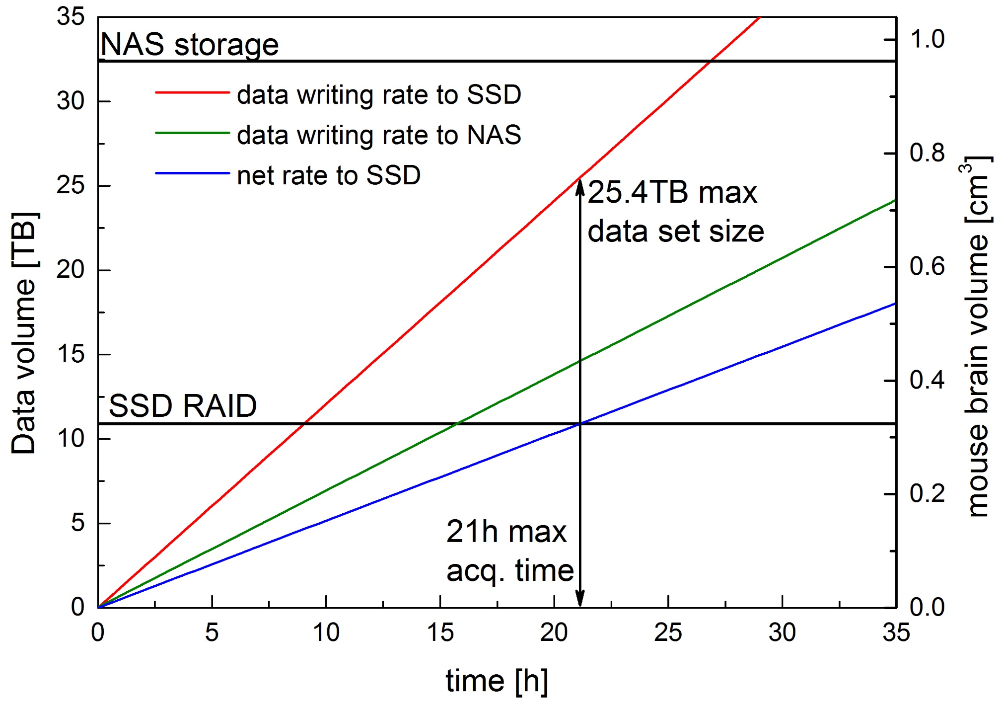
A
B
Camera
10 Gb Optical fibres
Remote repository
CINECA
CameraLink
board
10Gb network card
System
bus
Network-attached storage
32.4 TB
Raw data stream
Local SSD RAID 0
10.9TB
Data conversion stream
Transfer to remote repository
Workstation
Laboratory

Slide 23
Configure
Change hard-wired parameters (e.g. hardware ports names)
Update
Update run-time settings
(i.e. exposure time)
Main loop
Wait for user interaction and for messages from other components
Program start
Initialize
Set up hardware connections and load drivers
Terminate
Close all connections and drivers
Program end
Start
Begin grabbing images
Proceed
Grab images and decide to continue or not
Stop
Stop grabbing images

Slide 24
Tomo
Stack
Data Transfer
Camera
Motor Stages
Waveform
Generator
AOTF
(Shutter)
DAQ
Board
Laser
Modulator
Galvo
Scanners
Lasers

Slide 25
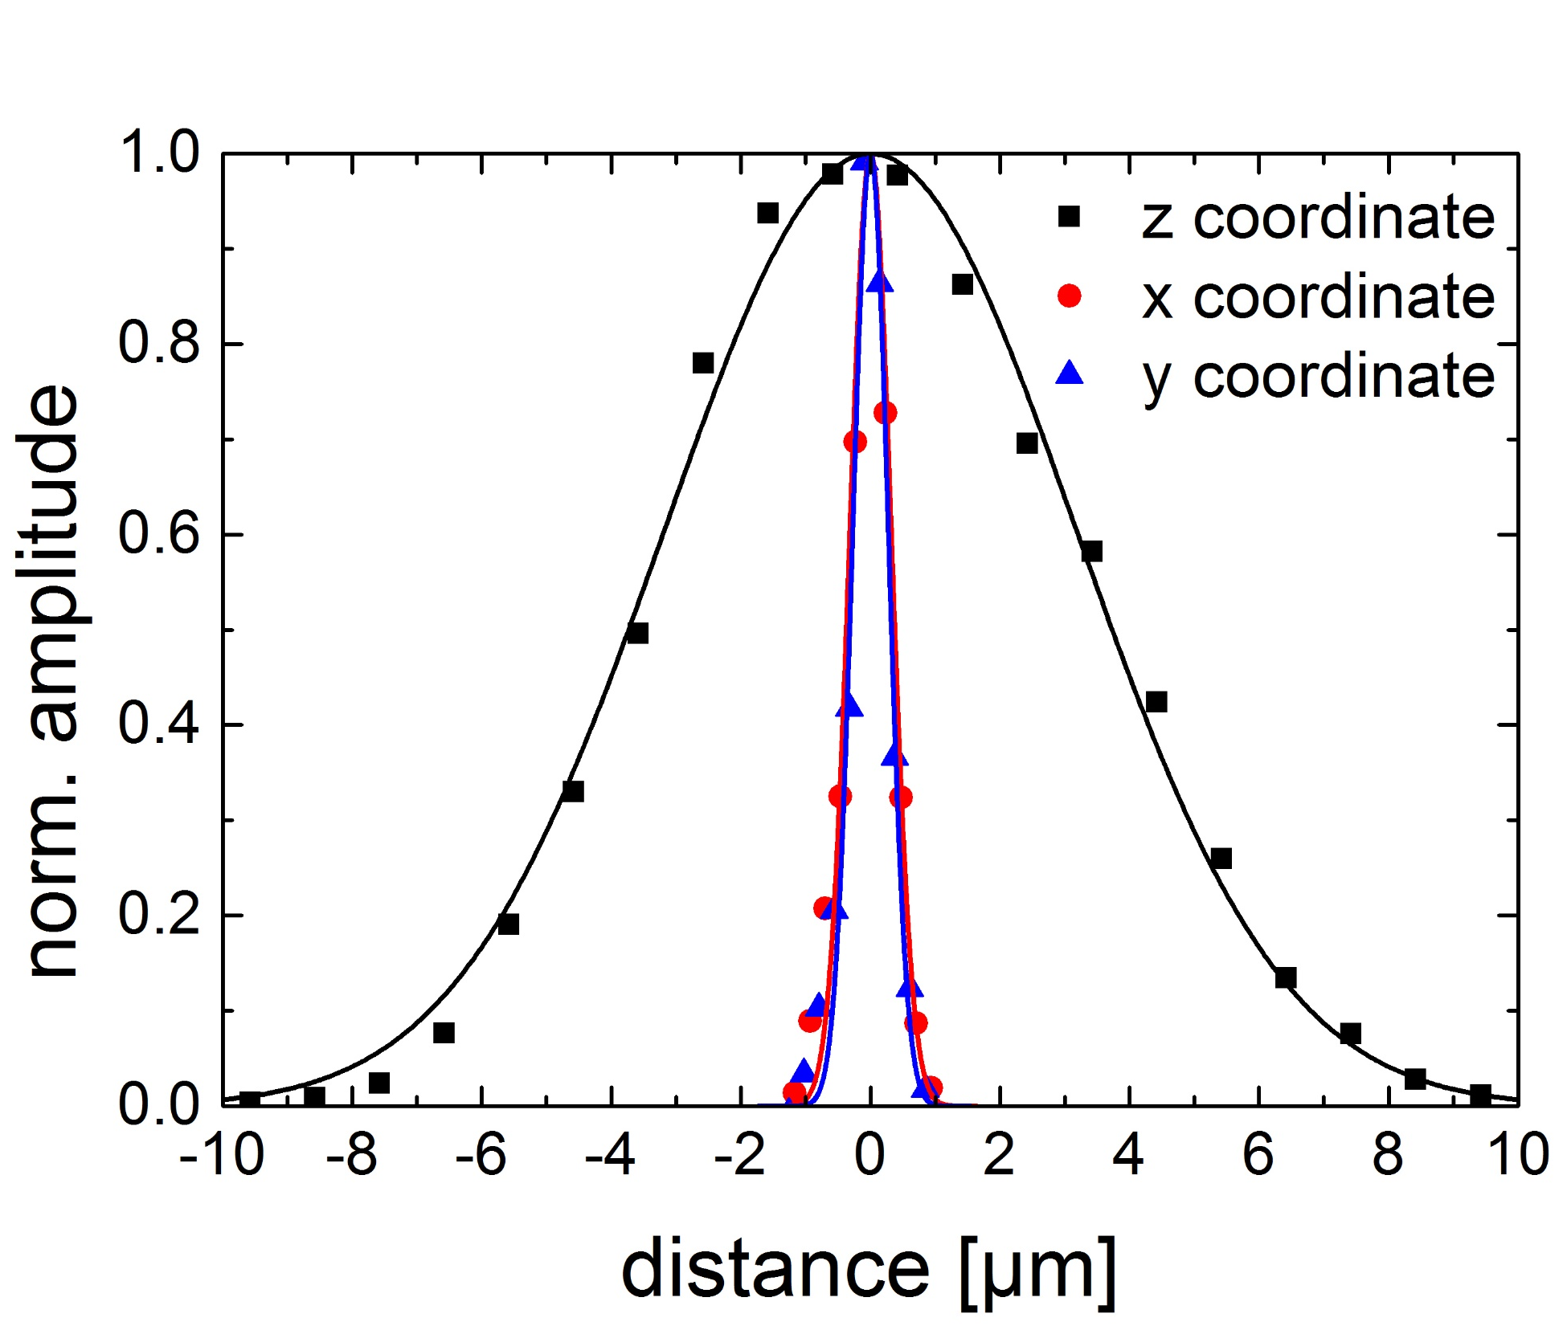
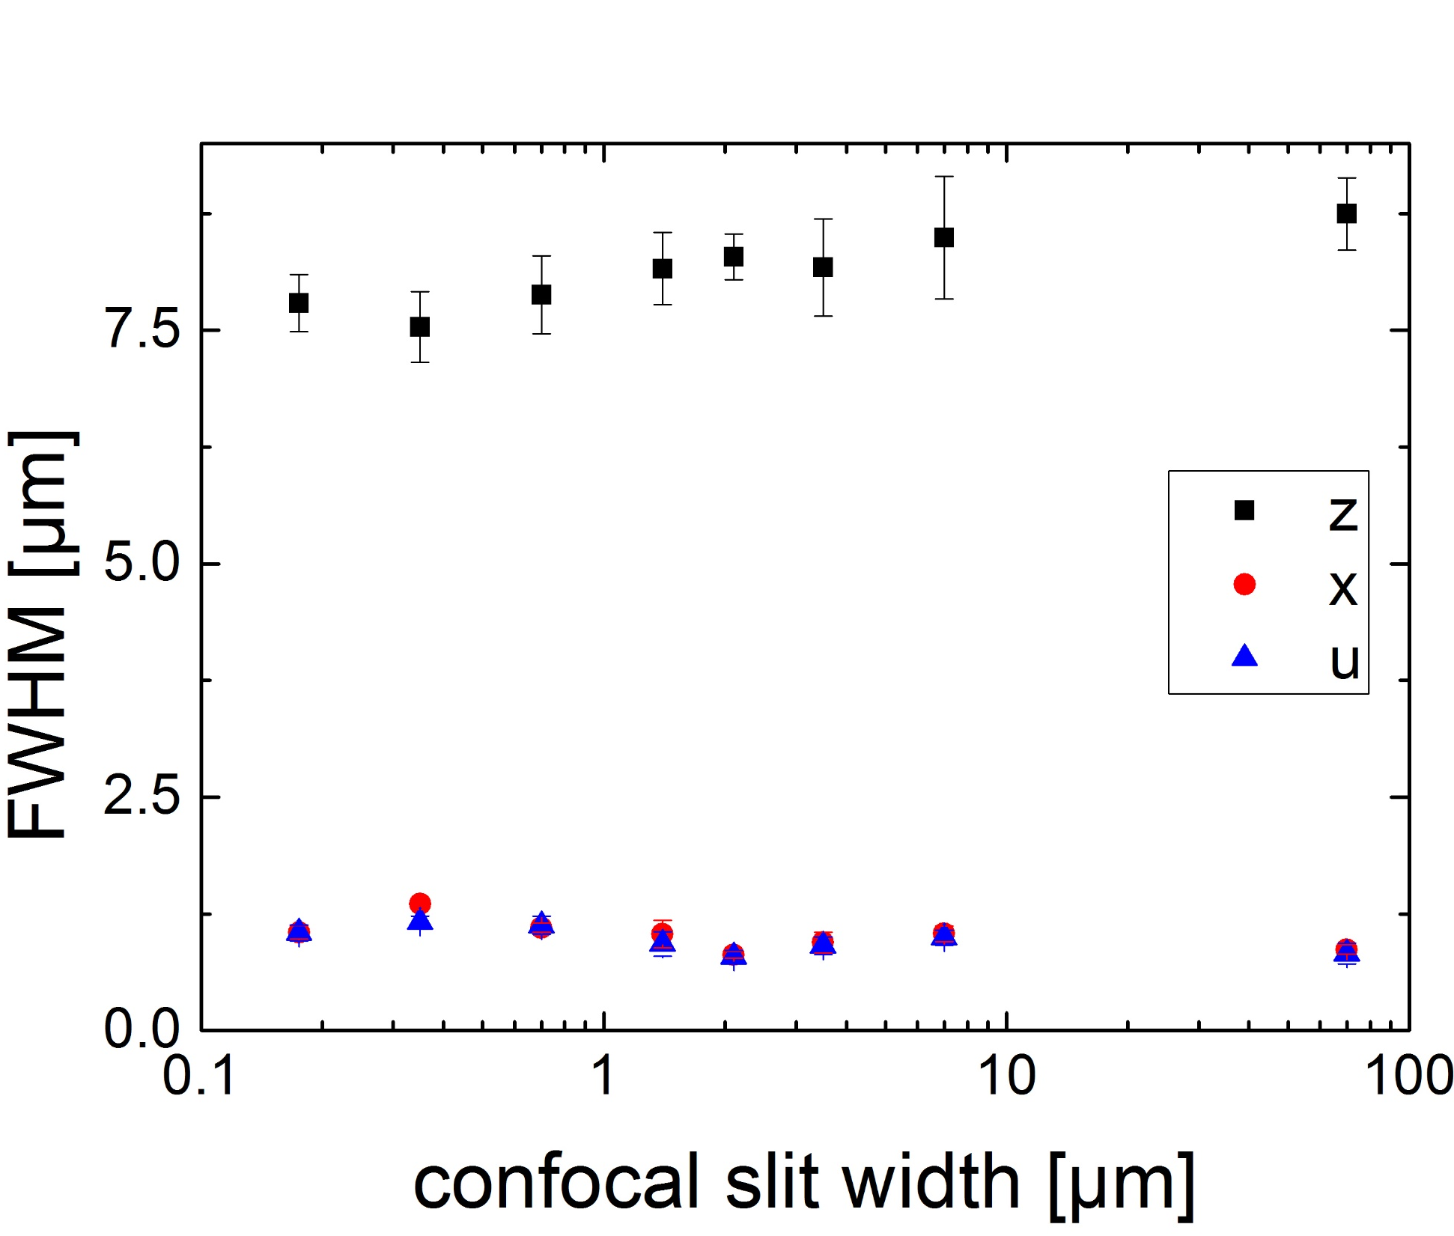
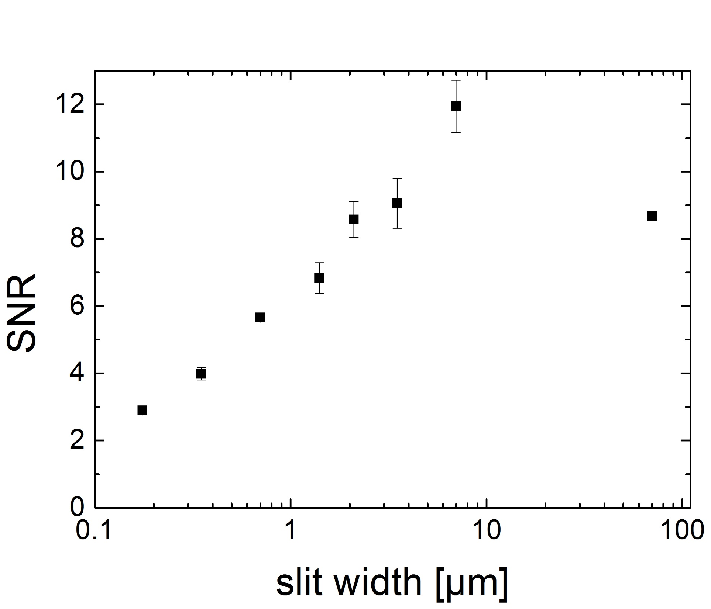
A
B
C

Slide 26
A
B
C

Slide 28
AD f=100
AD f=100
AD f=50

Slide 30
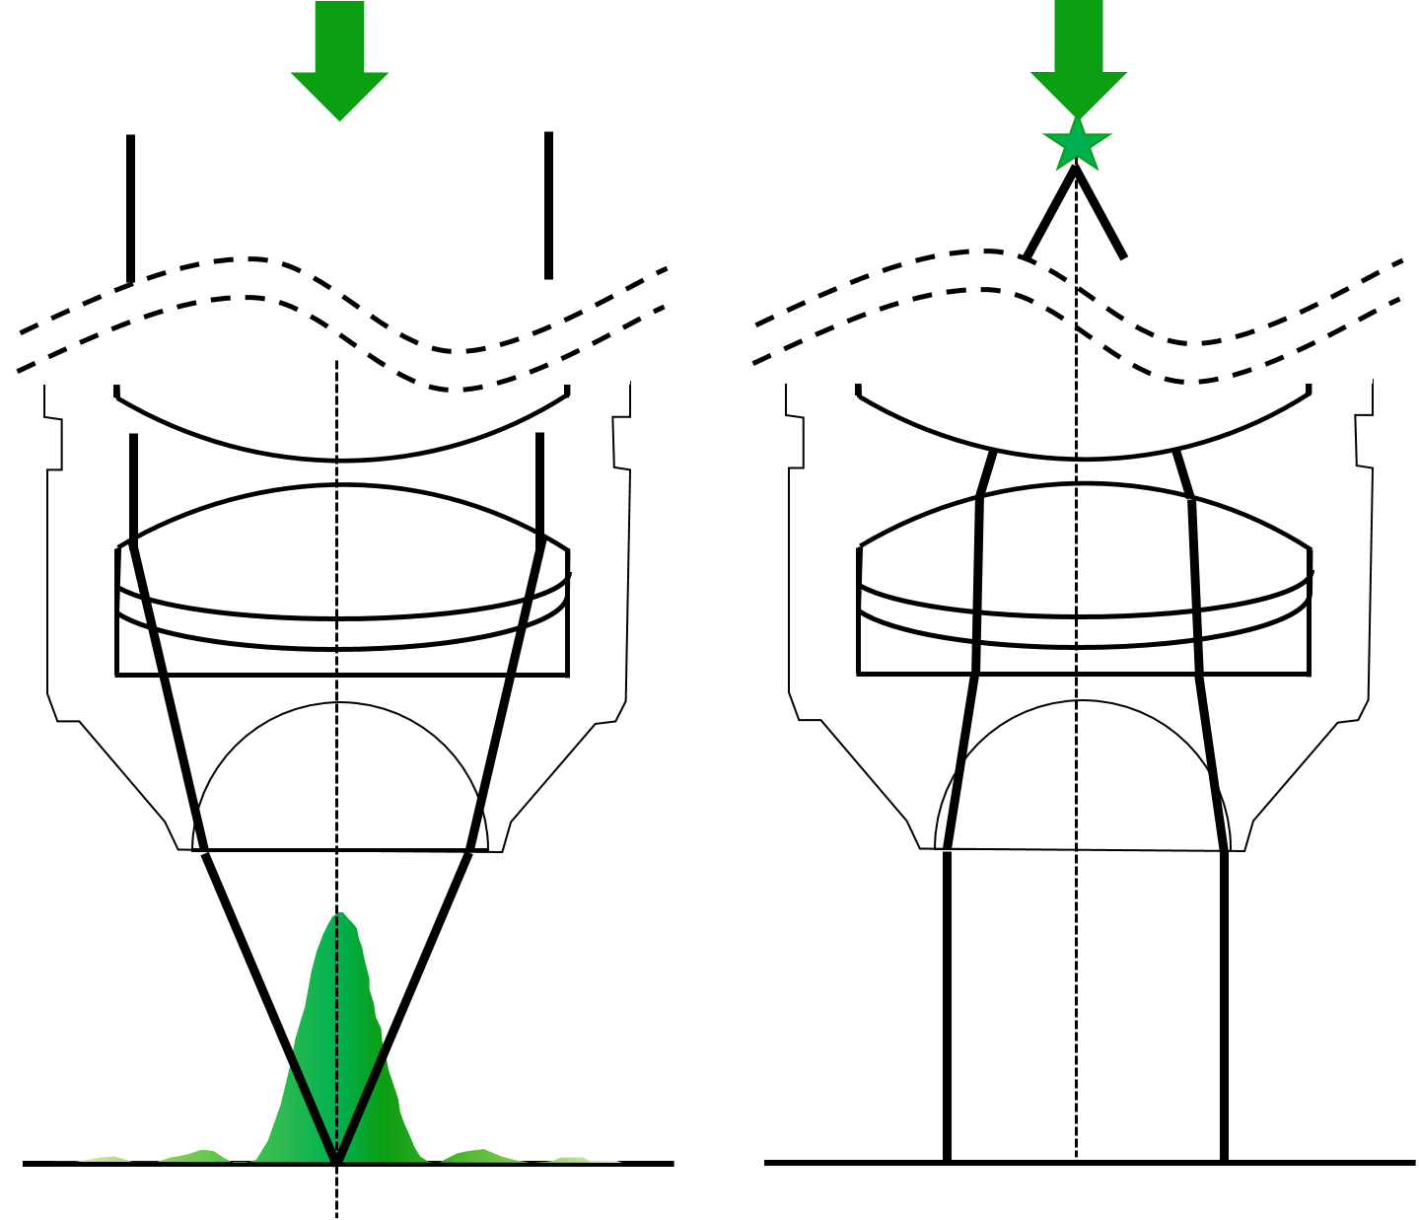
A
B
C
D

Slide 31
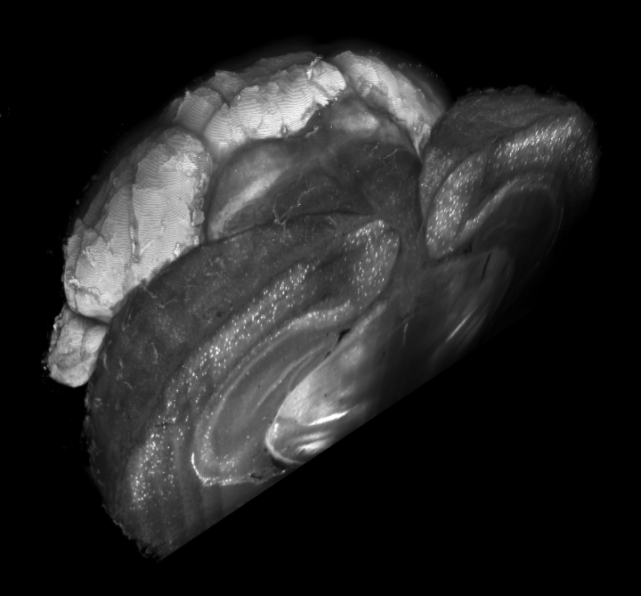
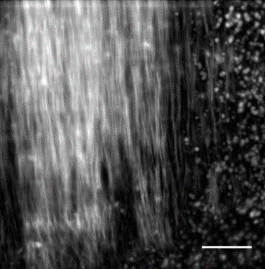



a
b
GAD
Vasc
d
PV
PI
c
PV
GAD
e
PI
f
Vasc

Slide 32




A
B
C
PV
PV
GAD
PI
D
GAD
E
PI

